Slide 1
Smart Mirror
20153208
이소영
What is Smart Mirror??
A smart mirror that shows you what you want using a mirror as a display monitor
the motivation of proposal
Difficult to manage time while watching the mirror
Difficult to look smartphone while makeup or styling
Function
Mirror is to display monitor
The mirror is show that time, date , weather ,etc…..
We can control the mirror through voice recognition.
Time reminder and smart phone status display via mirror

Slide 2
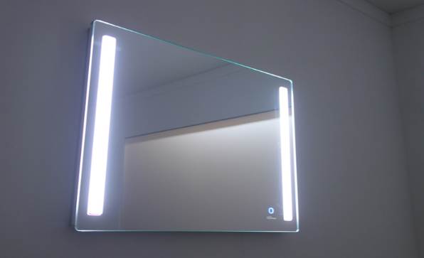
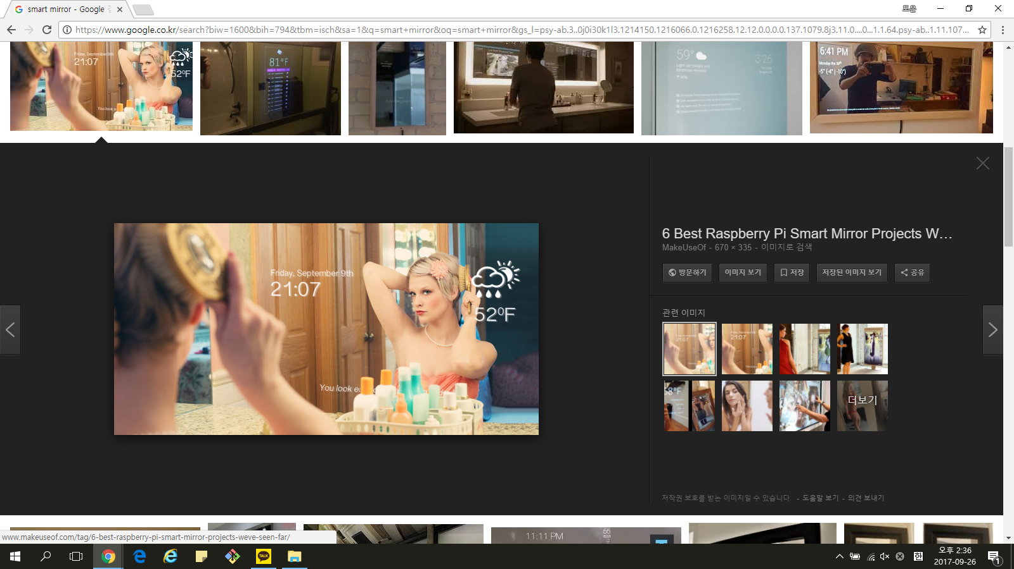
Design
List of required sensors and actuators
Raspberry Pi , LCD monitor , Clear glass , Mirror film, Usb microphone , etc….
system structure
wood
LED momitor
Raspberry Pi
Clear glass
Usb microphone
Mirror film

